Slide 1
KPI Analysis of Lowell General Hospital
TANISH

Slide 2
Problem Statement and Objective
Problem Statement:
Lowell General Hospital is committed to prioritizing patient well-being. To uphold this mission, we closely monitor key factors that impact patient safety and satisfaction. A structured analysis of these metrics is essential to identify trends, assess performance, and develop data-driven recommendations for enhancing customer satisfaction.
Objective:
Assess KPI impact on customer experience.
Analyze correlations between KPIs.
Benchmark performance and recommend improvements.

Slide 3
Dataset Overview
Source: Lowell General Hospital Dataset
Size: (60, 4)
Timeframe: 01/01/2020 to 01/12/2024
5 years
Key Variables:
Month
Average Licensed Bed Occupancy Rate
Unassisted Fall Rate per 1,000 Patient Days
Staff Responsiveness Domain Top Box Score
3 KPIs

Slide 4

Understanding KPIs
Average Licensed Bed Occupancy Rate
This measure is captured internally and is measured as a percentage. It is calculated as:
​

Slide 5
Understanding KPIs
2. Staff Responsiveness Top Box Score
The HCAHPS Survey, sent to patients post-discharge, assesses Staff Responsiveness through two key questions:
Q1. How often did you receive help promptly after pressing the call button?
Q2. How often did you get timely assistance with bathroom needs or using a bedpan?
It is calculated as:
​

Slide 6
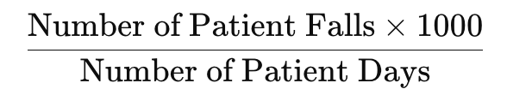
Understanding KPIs
3. Unassisted Patient Falls per 1,000 Patient Days
This measure is captured by the National Database of Nursing Quality Indicators (NDNQI). A patient fall is defined as an unplanned descent to the floor with or without injury. Unassisted falls are where there is no staff member present to assist the patient. This is measured as:
​

Slide 7
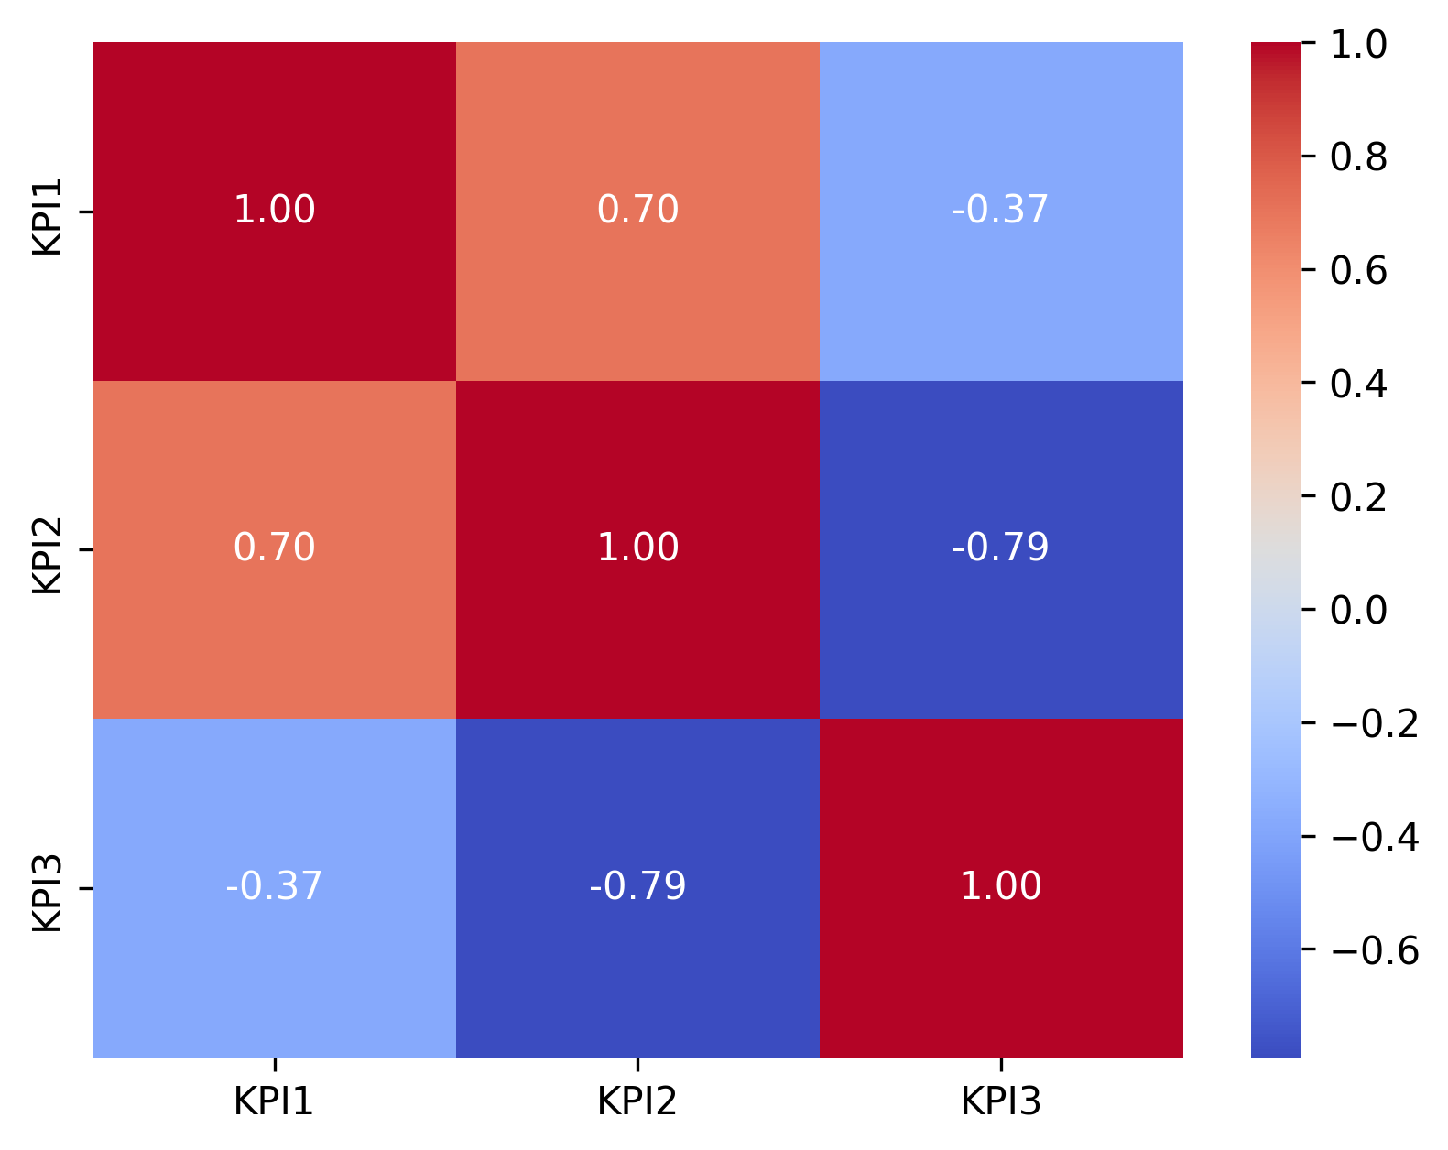
Relationship between the KPIs
Bed Occupancy Rate & Fall Rate per 1,000 Patient Days – 0.70 (Strong positive correlation)
Bed Occupancy Rate & Staff Responsiveness Score – -0.37 (Moderate negative correlation)
Fall Rate per 1,000 Patient Days & Staff Responsiveness Score – -0.79 (Strong negative correlation)
Heatmap of Correlations between KPIs

Slide 8
Relationship between the KPIs
Bed Occupancy Rate & Fall Rate per 1,000 Patient Days – 0.70 (Strong positive correlation)
As the bed occupancy rate increases, the unassisted fall rate tends to increase as well.
Interpretation: Higher bed occupancy (more patients in the hospital) might lead to increased pressure on hospital staff, which could result in a higher fall rate. This suggests a possible need for more efficient staffing or patient monitoring as occupancy increases.

Slide 9
Relationship between the KPIs
Bed Occupancy Rate & Staff Responsiveness Score – -0.37 (Moderate negative correlation)
As bed occupancy increases, staff responsiveness tends to decrease slightly.
Interpretation: Higher occupancy may cause more strain on hospital staff, potentially affecting their ability to be as responsive to patient needs. This could point to a need for better resource management or training in high-demand situations.

Slide 10
Relationship between the KPIs
Fall Rate per 1,000 Patient Days & Staff Responsiveness Score – -0.79 (Strong negative correlation)
As staff responsiveness improves (higher score), the fall rate tends to decrease.
Interpretation: Better staff responsiveness is strongly linked to fewer falls, which makes sense—responsive staff are likely to be more proactive in ensuring patient safety and preventing falls.

Slide 11
Relationship between the KPIs
Summary of Relationships between the KPIs:
Higher bed occupancy is associated with higher fall rates and slightly lower staff responsiveness. Hospitals may need to ensure that higher occupancy does not overwhelm staff, potentially compromising patient safety and care. Better staff responsiveness is strongly associated with fewer falls, indicating that when staff are more responsive, patient safety improves, and falls are reduced.

Slide 12
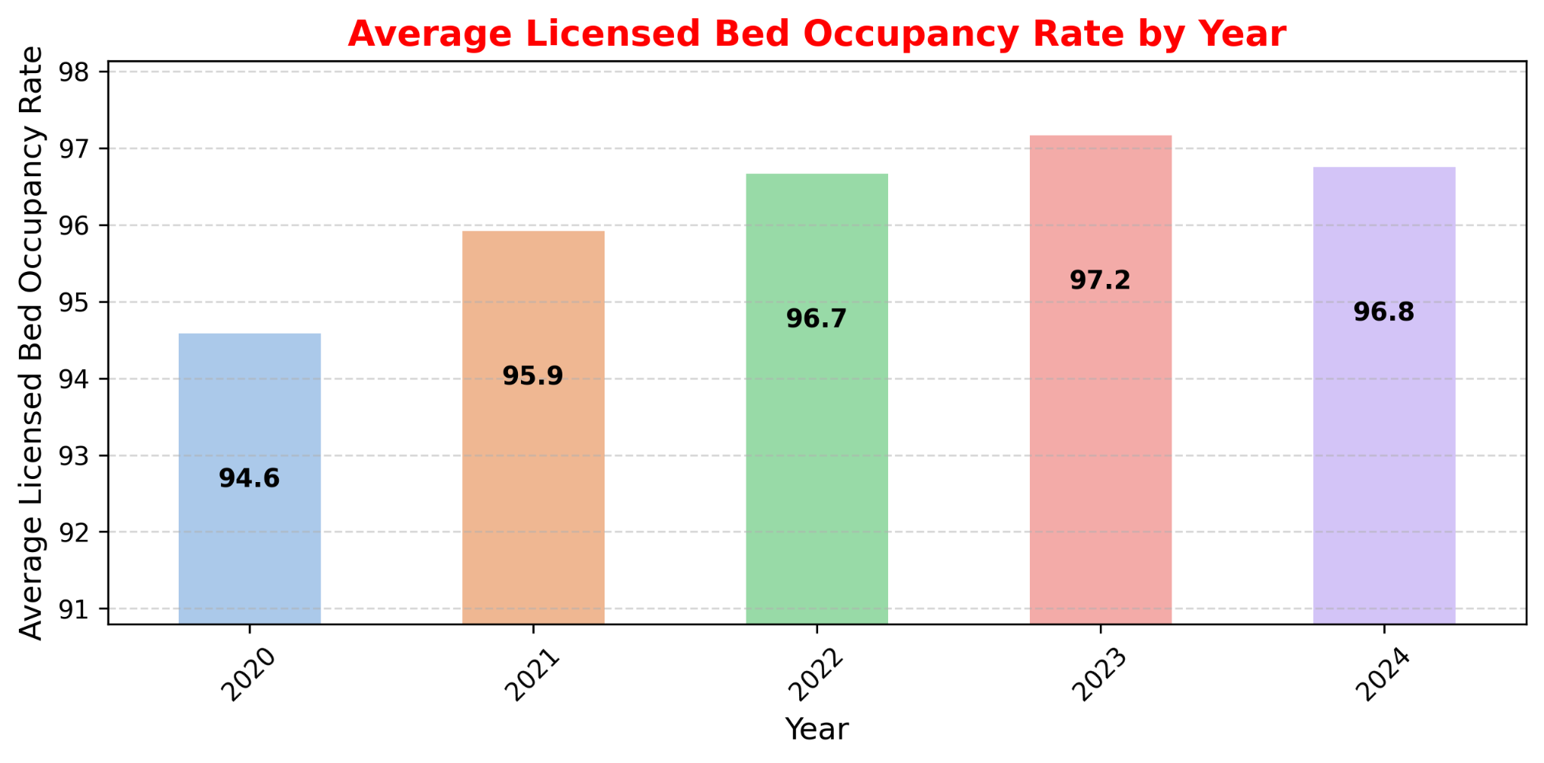
Trends in Data Over Time
Average Licensed Bed Occupancy Rate
Unassisted Fall Rate per 1,000 Patient Days
Staff Responsiveness Domain Top Box Score

Slide 13
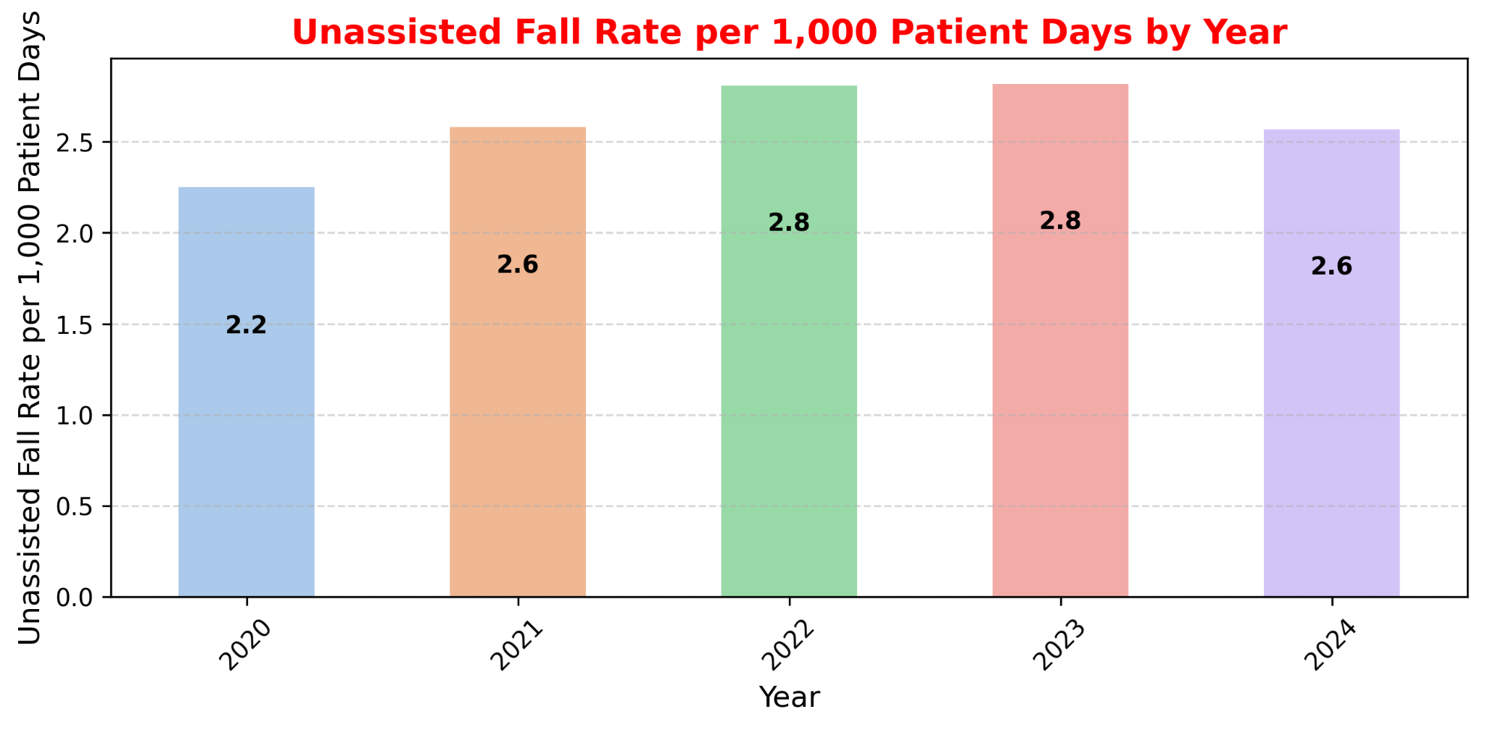
Trends in Data Over Time
Average Licensed Bed Occupancy Rate
Unassisted Fall Rate per 1,000 Patient Days
Staff Responsiveness Domain Top Box Score

Slide 14
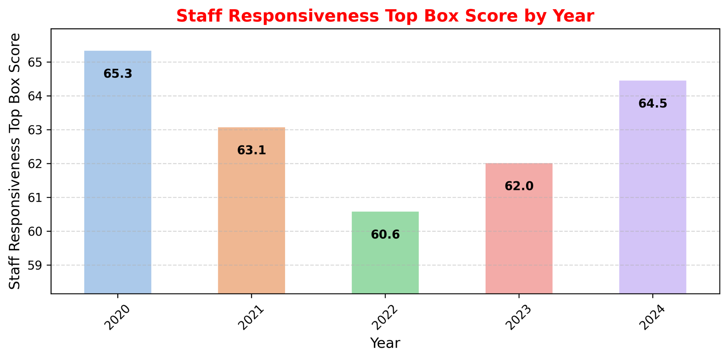
Trends in Data Over Time
Average Licensed Bed Occupancy Rate
Unassisted Fall Rate per 1,000 Patient Days
Staff Responsiveness Domain Top Box Score

Slide 15
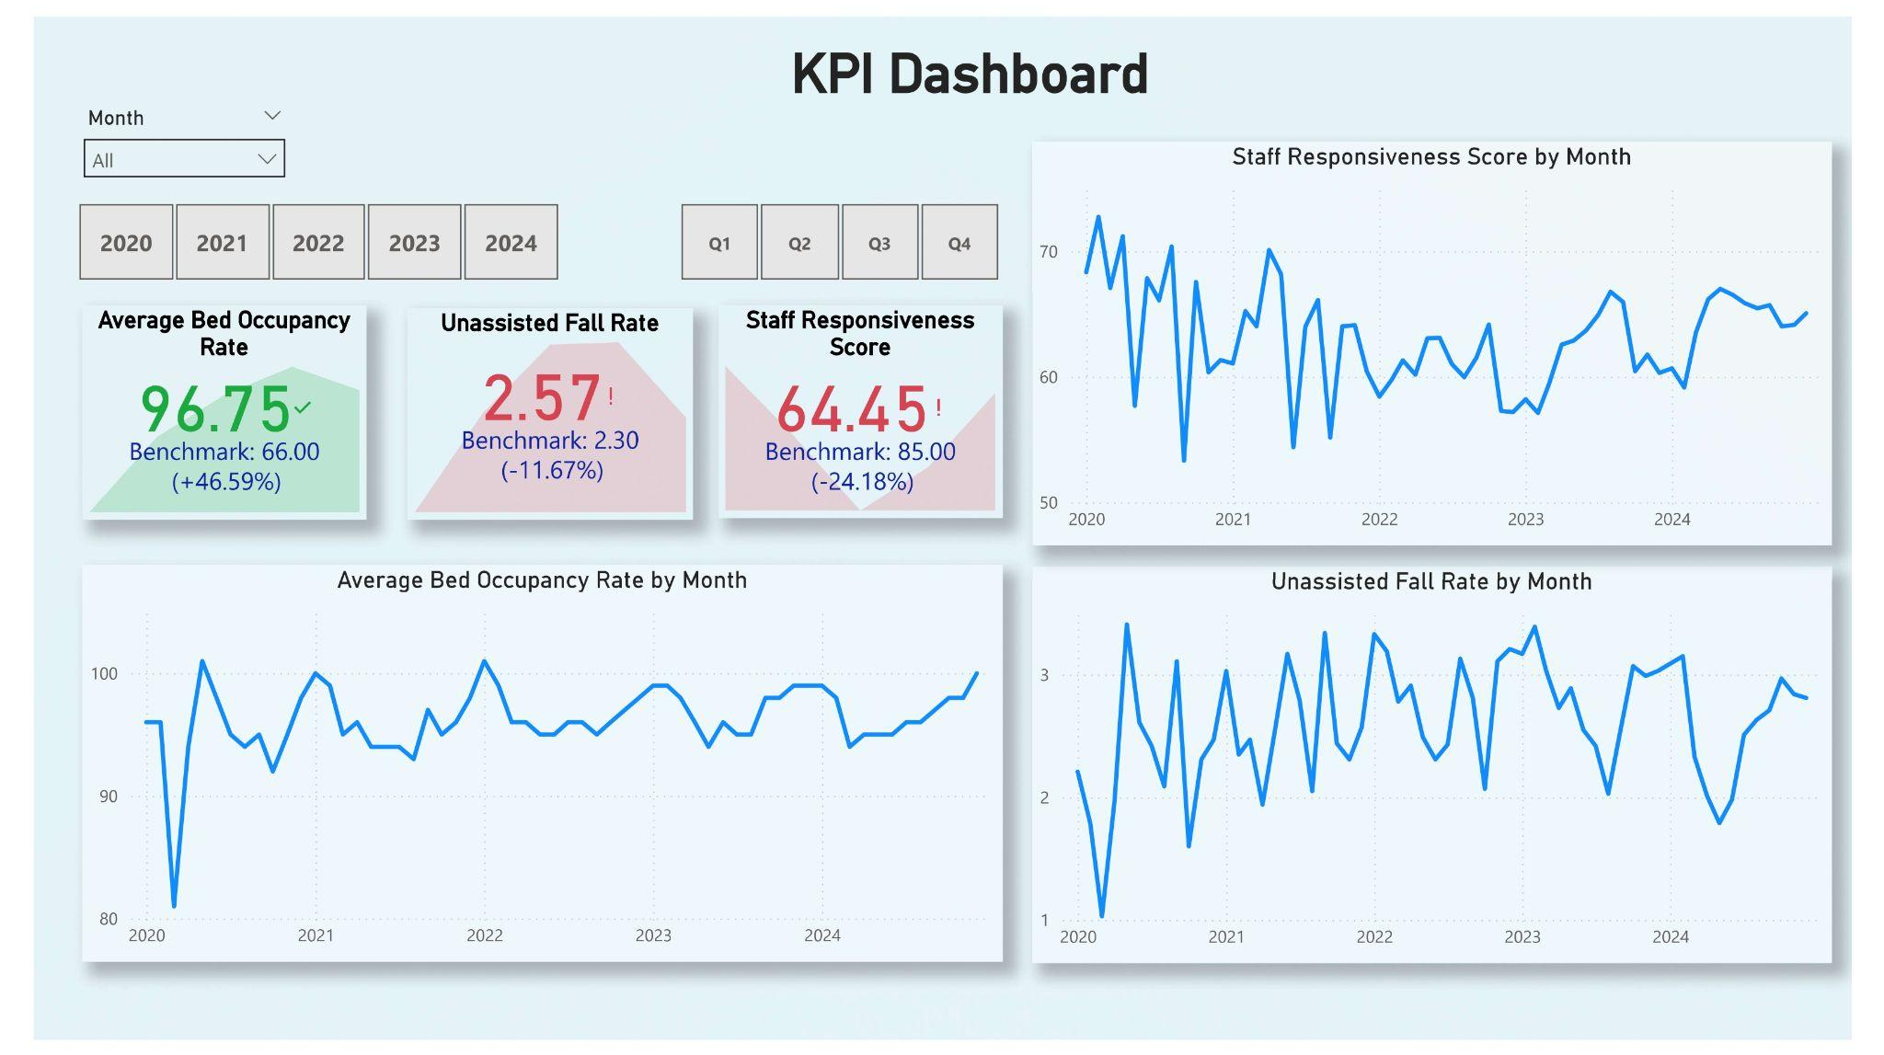

Slide 16
Benchmark Comparison
Average Licensed Bed Occupancy Rate
Unassisted Fall Rate per 1,000 Patient Days
Staff Responsiveness Domain Top Box Score
LG Hospital: 96.22%
U.S. benchmark: ~66%
Inference:
Your hospital has a significantly higher occupancy rate than the national average. This could indicate strong patient demand, efficient utilization of beds, or potential capacity issues. A consistently high occupancy rate above 85% might lead to overcrowding, strain on staff, and reduced patient satisfaction.

Slide 17
Benchmark Comparison
Average Licensed Bed Occupancy Rate
Unassisted Fall Rate per 1,000 Patient Days
Staff Responsiveness Domain Top Box Score
L.G. Hospital: 2.61 falls per 1,000 patient days
Benchmark: 2.3 – 13 falls per 1,000 patient days
Inference:
Your hospital's fall rate is on the lower end of the national range, which is a positive sign. It suggests good patient safety measures and fall prevention protocols. However, continuous monitoring is essential to prevent increases, especially with high bed occupancy.

Slide 18
Benchmark Comparison
Average Licensed Bed Occupancy Rate
Unassisted Fall Rate per 1,000 Patient Days
Staff Responsiveness Domain Top Box Score
L.G. Hospital: 63.09%
Benchmark: 85% – 90%
Inference:
Your staff responsiveness score is below industry standards, which may indicate delays in addressing patient needs. The high bed occupancy rate could be a contributing factor, as staff might be overwhelmed. Improving staffing levels, response times, and communication could help boost this metric.

Slide 19
Benchmark Comparison
Average Licensed Bed Occupancy Rate
Unassisted Fall Rate per 1,000 Patient Days
Staff Responsiveness Domain Top Box Score
Final Assessment
High Bed Occupancy and Low Staff Responsiveness suggest potential operational strain.
Despite high occupancy, fall prevention efforts appear effective.
Improving staff responsiveness may enhance patient satisfaction and overall hospital efficiency.

Slide 20

Thanks!
Contact:
Reet
+91-7980623308
reetphy@gmail.com

